Slide 1
UAMS
College of Medicine
JFR Faculty Hire Business Plan Template Training v17.03
April 8, 2015
Prepared by Richard M. Nuttall
Associate Dean of Finance

Slide 2
JFR Business Plan Template
General Principles
Always start with the latest template as this will become more and more sophisticated
You can find it on the JFR website under useful links
address: https://jfr.uams.edu/
The business plan requires all revenue and expenses to be categorized into 5 possible separate Proformas (P&Ls)…
COM
ICE
ACH
Institutes
Other (campus)

Slide 3
JFR Business Plan Template
General Principles…continued
Adding incremental faculty does not in itself generate additional teaching, administrative and clinical needs. If the business plan is adding additional FTE/expense to COM, you will be required to provide evidence of additional teaching, research, or administrative needs within the COM.
Note: replacing budget COM faculty is a valid concept☺
In general, the addition of clinical inpatient assignments do not generate incremental revenue. The business plan needs to outline how the collections are “incremental”, or new revenue to the budget (expense should be fairly easy to show it is part of the budget).
JFRs should never create equity issues. Equity concerns need to be addressed first before submission of a new faculty.

Slide 4
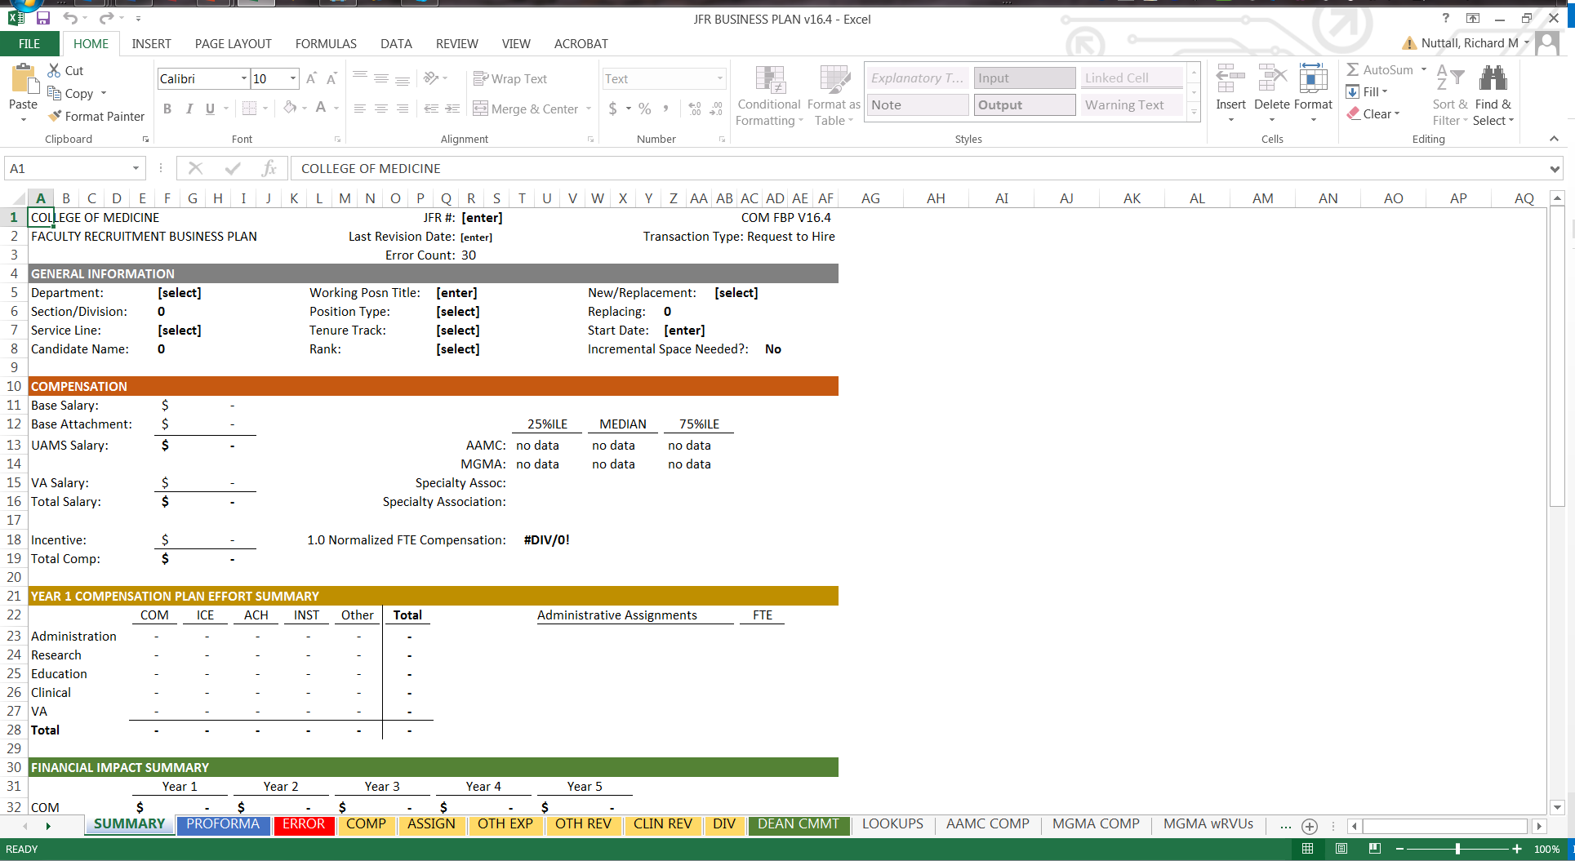
JFR Business Plan Template
General Principles…continued
The template is organized by tab…
Yellow are data entry tabs
Blue are JFR Committee tabs
Green is a blank Dean’s Commitment tab

Slide 5
Error Tab
This tab helps to keep a running total of the data entry errors within the whole business plan template.
There is a separate section for each tab.
When you get to zero that does not mean everything is accurate, just that you have filled in the boxes.
We’ll keep adding errors checks as we find common mistakes.

Slide 6
Compensation Tab
Each tab has data entry “error” counts to help ensure the template if fully completed
All faculty positions should always complete the AAMC specialty and degree. MGMA should be filled out when clinical faculty.
Weekly hours can be adjusted. Just indicate “why” in the box provided
If you have an existing Dean’s Commitment, you don’t have to fill out the Dean’s Commitment Form.
“Assis, Assoc, Prof”: use when you are not sure of the rank (pulls Assoc Benchmarks)
Position Budgeted?: this must be accurate or it will be sent back
This statement should be short and sweet. Long wordy justification are less likely to be read.

Slide 7
Compensation Tab
…continued
Adjust the fringe to reflect the best estimate of the position
This statement should be short and sweet. Long wordy justification are less likely to be read.
Selecting the total FTE and the VA 8ths will Auto calculated the split between the VA and UAMS
If the Department uses specialty association benchmarks for salary and wRVU, please enter them here
All JFRs require Dept to validate that the JFR will not create equity issues with current faculty
Indicate the stage of the salary negotiation

Slide 8
Compensation Tab
…continued
Enter which unit will pay for the “estimated” incentives and the funding source for the incentive

Slide 9
Assignment Tab
Each mission area has a dropdown for recognized assignments
The Assignment tab “distributes” the salary to the funding unit (i.e. ICE, COM, ACH, Institutes, or Other)
This section is only for modeling purposes. This allows you to use hours to help define the FTE
Enter which unit will pay for the “assignment” and the funding source
Enter the assigned FTE by year

Slide 10
Assignment Tab
…continued
If desired, you can itemize each clinical assignment and itemize revenue from each assignment
As you add expense to grants, contracts, foundation, gifts, Dean’s Commitments and Budget, the business plan will auto generate calculate the needed revenue in the proforma. Clinical revenues will have to be added separately.
Helps to ensure you have assigned the full FTE
This section is a summary of the assigned FTE

Slide 11
Other Expense Tab
Outline any space needs. Caution, if yes is entered here, this may hold up the JFR process until the space need is resolved.
This section is for common costs. This is to help ensure we capture these common costs for all faculty
These costs will auto populate depending on the “new/replacement” selection. These can be adjusted to align with expected costs.

Slide 12
Other Expense Tab
…continued
This section provides space to itemize any additional cost expected as part of this recruitment. Start-up packages would go here.
This section is for overhead costs. Enter additional overhead as needed.

Slide 13
Other Revenue Tab
This section provides auto calculates revenue based on expenses, such as salary support for grants, contracts, foundation, gifts, and Dean’s Commitments.

Slide 14
Other Revenue Tab
…continued
This section provides space to itemize any additional revenue expected as part of this recruitment, such as technical revenue, additional contract revenue, etc.

Slide 15
Clinical Revenue Tab
This section outlines the full volumes, wRVUs and Collections of all clinical assignments
This section allows for a cut and paste of CPT/charge/collection and wRVU details. These details can be for a single provider or a whole section
Enter the specific volume you expect for this one recruitment

Slide 16
Clinical Revenue Tab
…continued
Outline the level of ramp-up you expect from a new hire; first year expectation will not likely ever be 100%
Enter here the proportion of incremental revenue outlined in the assignments, and outline the rational (e.g. clinic wait times, expected growth, sending referrals to outside physicians, etc)
Enter which P&L the collections will apply

Slide 17
Division Template Tab
This tab’s aim to provide clear evidence that the current faculty working the same subspecialty as the position outlined in the business plan are working at or beyond expectations, thus defining the need for additional faculty.
These buttons expand additional rows or hide unused rows.
Enter the recognized assignments which define the difference between the faculty’s CFTE and their full FTE
Use this indicator to exclude this row from the analysis. This is helpful for midlevel providers.

Slide 18
JFR Committee will Review
The committee will review the first two tabs (Summary and Proforma)

Slide 19
UAMS
College of Medicine
JFR Faculty Appointment Action Template Training v17.02
August 16, 2016
Prepared by Richard M. Nuttall
Associate Dean of Finance

Slide 20
JFR Appointment Action Template
General Principles
Always start with the latest template as this will become more and more sophisticated.
You can find it on the JFR website under useful links
address: https://jfr.uams.edu/
The appointment action template was created to provide the department chair with a common format to justify the action.
Chair’s Justification (more than I support this action)
Budget impact analysis (will often require supplemental data and analysis if the action is part of a program)
Productivity analysis (currently only outlines clinical productivity)
Equity considerations

Slide 21
JFR Appointment Action Template
General Principles…continued
Appropriate approval documentation is required to be uploaded (email or MOU) if an appointment action is impacting more than just the department’s budget: ICE, institutes, campus, VA, etc.
An approval of an appointment action does not provide the entity with additional resources or funding, unless specified by a separate agreement.
JFR appointment actions should never create equity issues. Equity concerns need to be addressed first before submission of any appointment actions.

Slide 22
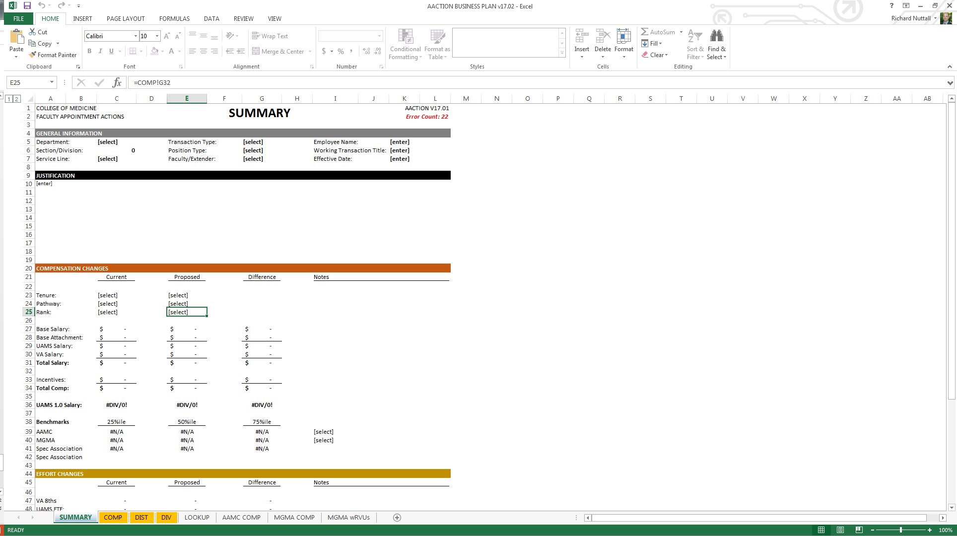
JFR Appointment Action Template
General Principles…continued
The template is organized by tab…
Yellow are data entry tabs
Blue are JFR Committee tabs
TBD: Green is a blank Dean’s Commitment tab
Light Gray are lookup tabs

Slide 23
Compensation Tab

Slide 24
Compensation Tab
Light Yellow = data enterable
Each tab has data entry “error” counts to help ensure the template if fully completed
Must fill out all categories (even if not applicable)
This statement should be short and sweet. Long wordy justification are less likely to be read.

Slide 25
Light Yellow = data enterable
Compensation Tab
…continued
“Proposed” is linked to current. Thus only need to enter requested change
Must fill out all categories (even if not applicable)
Enter in salary changes
All changes require a note or explanation
Enter in FTE changes

Slide 26
Light Yellow = data enterable
Compensation Tab
…continued
If the department utilizes subspecialty associate benchmarks, this template allows the department to enter those benchmarks here
Specialty association compensation benchmark name
Fill in the full grid of benchmarks by rank
Specialty association wRVU benchmark name
Fill in all percentiles

Slide 27
Distribution Tab

Slide 28
Light Yellow = data enterable
Distribution Tab
This section distributes the salary cost by assignment and unit
Enter in current FTE and changes to assignments
Each mission area has a dropdown for recognized assignments
“Proposed” is linked to current. Thus only need to enter requested change
Enter which unit will pay for the “assignment” and the funding source

Slide 29
Light Yellow = data enterable
Distribution Tab
…continued
This section distributes the incentive cost by mission and unit
Mission has a dropdown for the 3 missions
Enter which unit will pay for the “estimated” incentives and the funding source for the incentive
Enter in current FTE and changes to assignments
General sections to provide the JFR committee with more information as to the changes requested

Slide 30
Division Tab

Slide 31
Light Yellow = data enterable
Division Tab
This tab’s aim to provide clear evidence that the current faculty working within the same subspecialty are paid equitably and are working at or beyond expectations
These buttons expand additional rows or hide unused rows
Once complete, always push the “hide” button
Always unhide as you enter in divisional faculty
First row will be the appointment action subject
Select from the sub specialty benchmarks and MGMA and AAMC here
Enter in salary and incentive here
Enter in FTE assignment here
wRVU and Comp Plan Specialty will be automatically filled in, however it can be updated by person if desired
Enter divisional faculty here
Enter in prior 12 months of wRVUs here

Slide 32
Light Yellow = data enterable
Division Tab
…continued
This tab’s aim to provide clear evidence that the current faculty working within the same subspecialty are paid equitably and are working at or beyond expectations
Allows us to see the relative clinical capacity of the current faculty
Allows us to see the competitiveness of the division’s compensation structure
Add any comments needed to explain compensation variances or productivity variances

Slide 33
JFR Committee will Review
The committee will review the first two tabs (Summary and Proforma)

Slide 34
The end

